Slide 1
Item Bank Review and Enemy Identification with Natural Language Processing
Kirk A. Becker, PhD – Pearson VUE
Fang Peng, PhD – NWEA
JB Weir, PhD - NCCPA

Slide 2
Agenda
12:00-12:30 Overview of NLP and Enemies
12:30-1:30 Text Similarity
1:30-1:40 Break
1:40-2:40 Latent Semantic Analysis
2:40-2:50 Break
2:50-3:50 Topics Models
3:50-4:00 Wrap up

Slide 3
What is NLP being used for in Educational Measurement?
Automated essay scoring
Automated speech scoring
Automated scoring of short constructed response
Item bank evaluation for content coverage
Automated referencing
Identification of enemy items/content overlap
Item classification
Classification of interviews/narratives/personal histories according to psychological models
Automated item generation
Item writing aides (distractor modeling)
Reading assessment (Metametrics/MUSE)
Item difficulty modeling
Test/Simulation log analysis
Item Selection for Personality Tests
CAT starting theta based on text mining
Expert systems

Slide 4
What is an Enemy Item Pair
Items that should not appear together due to content
Overlapping/identical knowledge required
Cuing – one item provides information about the other
Construct Limiting - Different knowledge, but same specific area

Slide 5
Why do Enemies Matter?
Validity - Construct representation
Test taker experience
Psychometric considerations (equating, calibration, reliability)

Slide 6
NLP/Enemy Detection Statistical Tools
Text overlap/similarity
Factor Analysis/Latent Structural Analysis (SVD)
Conditional Probability and Independence
Naïve Bayes classifiers
Training/Verification Samples
Ontologies
Notes:
The idea here is to show attendees that many of the methods used in NLP are statistical tools that they probably already know about – they’re just applied to linguistic variables/models

Slide 7
NLP Linguistic Concepts
Polysemy
Parts of Speech
Corpus
Vector/Semantic Space
N-gram
Semantic similarity
Colocation/ cooccurence
Ontology
Tokenizing
Word Sense Disambiguation
Bag of Words Models
Normalization
Stemming
Lemmatization
Transformer Models
Notes:
I wanted to start with a set of NLP concepts that participants may not know too much about – the linguistic concepts – and let them know we’re going to provide a primer on the important ideas

Slide 8
Text Similarity
Semantic Vectors
Latent Semantic Analysis
Topics models
Overlap/Jaccard/Matching/Dice
Cosine similarity
tf/idf weighting

Slide 9
Tokenizing
We need to break text into standardized units (typically words or phrases) called tokens
Tokens are the basic unit of many analyses
Important concepts
Lemmatization vs. stemming; polysemy
Stop words
N-Grams and Phrases
Output (Document-Term Matrix, Bag of Words models, other statistical models)
Notes:
Regarding essay scoring: We would probably want to do a lot of processing on each essay, including tokenization (for, say, a bag-of-words model), but probably also including parsing sentences to determine average sentence length.

Slide 10
Ontologies
Ontology: A database representing domain knowledge as a hierarchy of concepts and relations
WordNet
UMLS
Cyc/OpenCyc
Ontologies represent accumulated knowledge
Ontologies are combined with statistical tools to improve NLP outcomes
Notes:
Regarding essay scoring: We might have an database (loosely an ontology) of word “levels” so that we can assign a mean or median word level to each essay.

Slide 11
Part of Speech (POS) Tagging
Using rules, machine learning, etc. label the part of speech of each token; e.g.:
Our/PRP plane/NN banked/VBD ./.
I/PRP planed/VBN the/DT bank/NN door/NN ./.
Our/PRP plane/NN hit/VBD the/DT bank/NN ./.
Our/PRP bank/NN was/VBD hit/VBN ./.
Our/PRP play/NN was/VBD a/DT hit/NN ./ .
In essay scoring, POS tagging can help clarify word meanings and can be used to build models to assess grammar
Notes:
These are examples of short sentences tagged by a online tagger hosted at the University of Illinois (http://cogcomp.cs.illinois.edu/demo/pos/). These sentences use the same or similar words (bank, plane, hit) as nouns and verbs. It helps to understand the first sentence, “Our plane banked.” to know that “plane” is being used as a noun and “bank” is being used as a verb. In the second sentence, “I planed the bank door” these roles are reversed (although you could argue either that “bank” is a adjective or that “bank door” should be a compound phrase).
Most POS taggers use dictionaries to determine possible parts of speech and then rules to help select specific parts. For example, determiners are words like “the” or “a” and an adjective or noun usually follow a determiner.

Slide 12
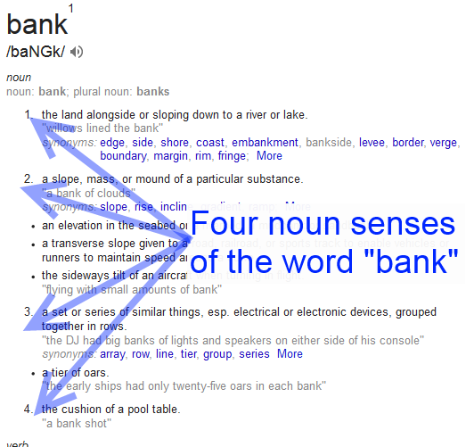
Word Sense Disambiguation (WSD)
A sense is the specific meaning
Organized by part of speech
Senses can vary dramatically
Often starts with POS

Slide 13
Vocabulary
Building a Corpus
Many NLP methods may be dependent on the size of your corpus
The corpus can be constructed from a variety of sources
Word co-occurence
Constructing/Interpreting a Semantic Space
Each domain will have its own vocabulary
i.e., we may need a corpus for each test or even for domains within a single exam
Notes:
I want to get to the fact that different groups may have their own vocabulary – like academic vs. literary vs. general English as part of the discussion on constructing a corpus, then get into why that matters

Slide 14
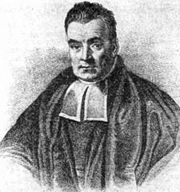

Naïve Bayesian (NB) classification
Naïve refers to an assumption, but NB classification is known to be very effective
Based on Bayes (1763) theory
The beauty of Bayes theorem is that it we want to know p(c|d) and we can compute the other terms (with the naive assumption)
Thomas Bayes?
(1701 – 1761)
Notes:
P(c|d) = probability of a class (class i) given some data d
P(d|c) = the probability f the data d given a class
P(c) = the probability of a class (this is the prior; if 25% of instances are members of the class, P(c)=0.25
The beauty of Bayes theorem is that it we want to know P(c|d) and we can compute the other terms (with the naive assumption)

Slide 15
Why Naïve Bayes Classification?
Predict nominal classes (domain) from nominal predictors (presence of specific words)
Handle problems with many predictors
Have a history of successful application
Are computationally simple
Have been shown to be robust to technical issues like high degrees of multidimensionality and noise

